Slide 1
Peer Discovery With Transitive Trust in Distributed System
Changliang Luo
Faculty of Electrical Engineering, Mathematics and Computer Science
Delft University of Technology
October 20, 2017
Notes:
Hello everyone, the title of my thesis is Peer Discovery With Transitive Trust in Distributed System. Seeing the title one may ask: what is peer discovery, what is transitive trust, what is distributed system. Before answer those questions in a formal way. I will tell a small story, try to give you a first impression of the concept of Peer Discovery and Distributed Systems.

Slide 2
Peer Discovery in Real Life
Imagine that you are a person in the 1970s.
You are trying to finding an old friend (Jack) – your roommate when you were in the University 10 years ago.
No Twitter, Facebook, phone number etc.
How can you find him/her?
Notes:
Imagine that you are a person in the 1970s. You are trying to finding an old friend – your roommate when you were in the University 10 years ago.
As we know, in 1970s, there is no social networks like Twitter and Facebook. There was telephone at the 1970s, but unfortunately, you don’t have the telephone number of your old friends. Given these, how can you find your old friend?

Slide 3
Solution 1
Put the living address of all people in this planet in a single address book, then put the address book in somewhere everyone knows.
Therefore, you can find the living address of your old friend in such a address book.
Notes:
You might hope there is an address book which is maintained by certain organization. The address book contains the address of all people living in this world. If so, the only thing you need to do is retrieving your old friend in this address book.

Slide 4
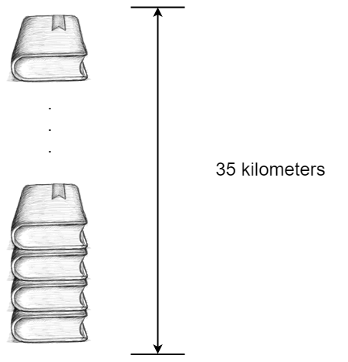
Solution 1
1 page for 20 people
1000 page for 20000 people with 10 centimeters thick
7 billion people in this world
Therefore we need an address book with 35 kilometers thick.
Notes:
However, if there is such an address book, it may be 35 kilometers tall: say 1 page for 20 people, 1000 page for 20 thousand people with 10 centimeters thick. For 7 billion people in this world, we need an address book with 35 kilometers thick. Even we have such a address book, the address tower, we still have several issues, for example, we need to have a perfectly nice organization to hold the address book, otherwise we might face the trouble that big brother is watching you. Generally speaking, such an address book is not realistic.

Slide 5
Solution 2
Request help from other people
If they have no idea where is your old friend, request them to introduce someone who might know to you.
Move on, until you find your old friend
Notes:
An Alternative solution is requesting help from others. In fact, it is the way we use in daily Life. You can ask other people about the address of your old friend Jack. For example, you can visit another old friend, asking “Hey, Charlie, do you know where is Jack now?”, if Charlie knows, he will tell you the address. But it is likely that Charlie also has no idea about that the address, but he knows someone might know. So, he might anwser you: “I don’t know, but I think Frank might know, I will tell you the address of Frank, you should contact him”. Then you contact Frank. Then you contact next person, by moving on like this, you will finally find Jack.

Slide 6
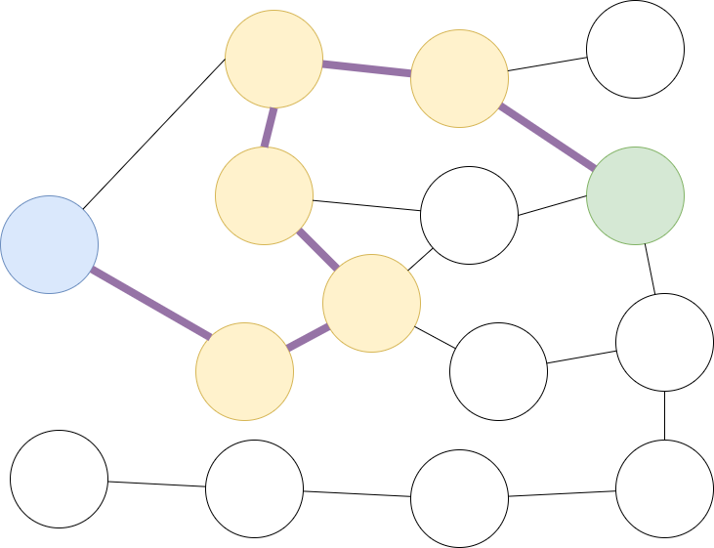
Solution 2 – Normal Case
May take detours
In general, you will get closer and closer to your old friend
Notes:
The graph depicts the process.In the Graph, the Blue circle represents you, the green circle representing your old friend, Jack. The yellow circles represent the people you ask for help. You may take some detours. However, in general, you are getting closer and closer to Jack and eventually find him.

Slide 7
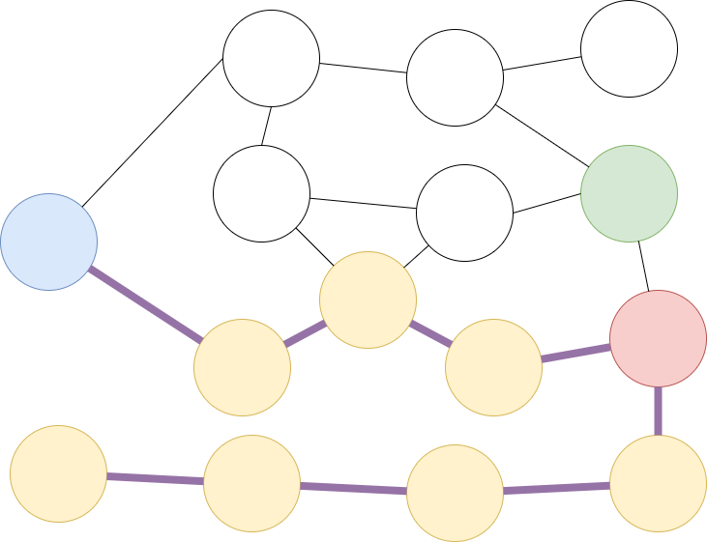
Solution 2 – Misleading Attack
You meet a bad guy (red)
Instead of telling you the address of your old friend (green), he/she introduces irrelevant people to you
Notes:
But there is another story. You visit a bad guy, a liar, marked with red. He/she intentionally introduce wrong people to you. You are mislead to somewhere else. You might not be able to find Jack. That is a major flaw for this peer discovery approach, but how can we prevent this situation? It is the research question this thesis wants to anwser, but before that, we should first formalize the definitions of distributed system and peer discovery.

Slide 8
Definitions
A Distributed System is a set of peers as a whole where peers cooperate with each other for certain goals.
Peer Discovery is a process that peers attempt to locate the other peers.
Notes:
Before introducing the very formal definition, we can draw a definition for Distributed System and Peer Discovery using natural languages： a distributed system is a set of peers as a whole where peers cooperate with each other for certain goals. In our story, the people are peers, the people as a whole can be seen as a distributed system. The goal is finding the address of Jack, it can also be other people. The definitions here are not very formal, but it might help you to catch the main idea of Distributed System and Peer Discovery.
Peer Discovery is a process that peers attempt to locate the other peers. In our story, finding the address of Jack is a peer discovery process, it is a process that discover a certain peer. But it can also be a random people.

Slide 9
Definitions
Distributed System: A distributed system is a collection of independent computers that appear to its users as a single coherent system [1].
Client/Server Architecture: A Client/Server network is a distributed network which consists of one higher performance system, the Server, and several mostly lower performance systems, the Clients. The Server is the central registering unit as well as the only provider of content and service. A Client only requests content or the execution of services, without sharing any of its own resources[2].
Peer-to-Peer Architecture: A distributed network architecture may be called a Peer-to-Peer (P-to-P, P2P,...) network, if the participants share a part of their own hardware resources (processing power, storage capacity, network linkcapacity, printers,...). These shared resources are necessary to provide the Service and content offered by the network (e.g. file sharing or shared workspaces for collaboration). They are accessible by other peers directly, without passing intermediary entities. The participants of such a network are thus resource (Service and content) providers as well as resource (Service and content) requestors (Servent-concept)[2].
Notes:
Formal definitions for Distributed System is listed below: The definition limit the scope in computers only. according to this definition, Internet is a typical distributed system. In addition, distributed system can also be further divided into two subclass Client/Server Architecture and Peer-to-Peer architecture. The difference is that Client/Server architecture assumes different roles for peers and assumes different functionality, responsibility and different amount of performance for different roles but Peer-to-Peer architecture does not have such assumption.

Slide 10
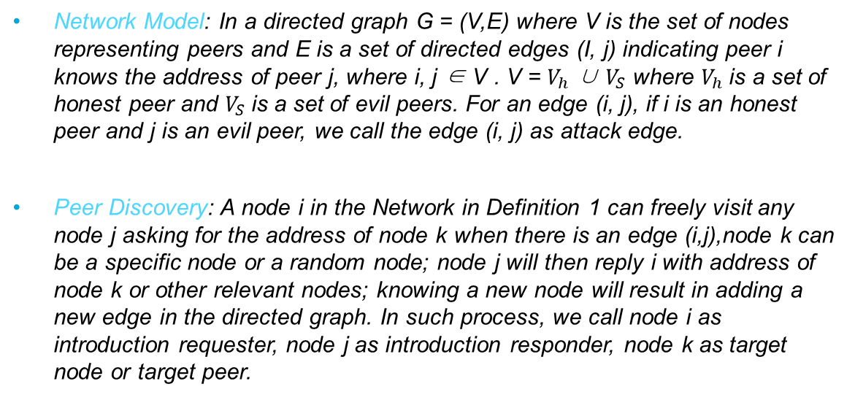
Definitions
Network Model: In a directed graph G = (V,E) where V is the set of nodes representing peers and E is a set of directed edges (I, j) indicating peer i knows the address of peer j, where i, j ∈ V . V = $V_{h}$ ∪ $V_{S}$ where $V_{h}$is a set of honest peer and $V_{S}$is a set of evil peers. For an edge (i, j), if i is an honest peer and j is an evil peer, we call the edge (i, j) as attack edge.
Peer Discovery: A node i in the Network in Definition 1 can freely visit any node j asking for the address of node k when there is an edge (i,j),node k can be a specific node or a random node; node j will then reply i with address of node k or other relevant nodes; knowing a new node will result in adding a new edge in the directed graph. In such process, we call node i as introduction requester, node j as introduction responder, node k as target node or target peer.
Notes:
Now we have the formal definition for Distributed system, let’s make a definition for peer discovery as well. The definition is on the screen. We assume a network in the distributed system, we use a directed graph to represent it, we use nodes to represent peers and edges to represent the fact that a peer knows the address of another peer. We also assume different nature of peers, some peers are honest and some peers are evil, for example, the liar in our story is a evil peer. With the network model, we define peer discovery as searching peers in the network. Now we have the concept of Peer Discovery, Before directly go to our research question, let’s quickly go through some applications about peer discovery.

Slide 11
Research Question – How to defend Misleading Attack
Notes:
Now, we can get back to our question, how to prevent Misleading Attack. In fact, this kind of peer discovery approach is not only used in the cyberspace but also in our daily life, we might get some inspirations from our daily experience.

Slide 12

First Mechanism – outrun in number
Notes:
In our daily life, we are not that vulnerable to Misleading Attack. There are two mechanisms protecting us from such attack. I never hear news like somebody is misleaded to the other side of the planet. So, what mechanisms are protecting us. First, Misleading Attack is a passive attack, the attacker can do nothing until we come to request introduction. But there are many people around us, we might not choose the attacker to request introduction. To solve this, a single attacker can cooperate with others to form a evil union, a coalition. Therefore, if we visit anyone of the union member, they can launch Misleading Attack. However, compared with the honest people in the world, the union members are few in number, hence the probability that we visit a evil union members is limited. That is the first mechanisms to protect us in daily Life. However, in cyberspace, I mean, on the Internet, such mechanism doesn’t work well. In our physical world, we interact with other people through our body, in other words, our body is an agent of our mind. Everyone in this world has only one body, hence one agent. Since the evil minds are few in number, the evil agents are also few in number. But in cyberspace, that does not hold. Even evil minds are few in number, evil agents can be enormous.In cyberspace, we interact using identities like Facebook Account, Twitter Account, Gmail Accounts etc. Hence an attacker can have multiple agents. Identities, we can also call it agents, that controlled by a single entity is called Sybils.

Slide 13

Sybil
Notes:
An example is this. A bot in Trumps fans account, it is controlled by a certain organization, rather than the real Nicole Mincey. People doubts that there are more bots in Trump’s fans account. That implies a possibility that there is one organization wielding multiple accounts to create an illusion that there are many people support or despite the opinion of Trump. Let’s back to our Misleading Attack. An attacker can also create a lot of sybils and throw them into the network. Because we can not reveal the controller, the mind behind an identity, we will consider Sybils as normal people. Hence by using sybils, attackers can wield a great power that they should not have. If the Attacker inject enough Sybils to the network, we will have a very great chance to request introduction from a sybil hence will easily suffer Misleading Attack. So, as I say, the first mechanism in our daily life cannot protect us in cyberspace.

Slide 14
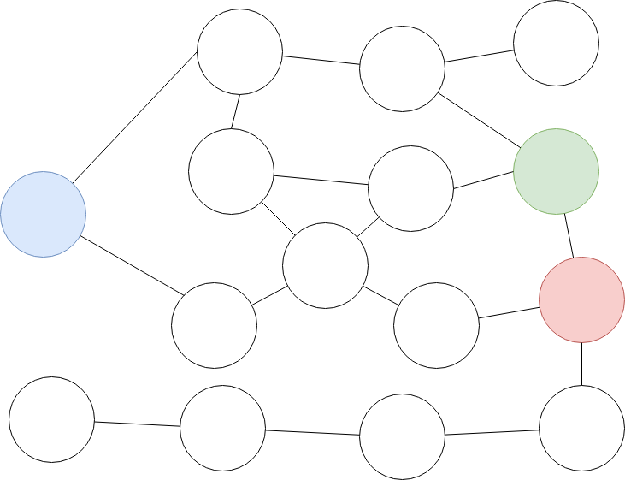
Second Mechanism
Notes:
The second mechanism protecting us is trust. In our daily life, we will not unconditionally other people. We trust our parents, our friends more than a random stranger. We actually assign everyone a round us with a trust value, a reputation. We will treat the introduction from a person who has a high-trust value more seriously than the introduction from a low-trust value person. We assign the trust value according to the historical behaviors behind every person – if he/she used to benefits us a lot, we trust them more, otherwise we trust them less. By assigning trust value to people and treat people according to the trust value, we can significantly prevent the Misleading Attack in our daily life. Unlike the first mechanism, this mechanism also looks well in the cyberspace. So, what if we apply this mechanism to the peer discovery approaches to combat Misleading Attack? I mean can we combat the Misleading Attack based on trust among peers? To test this idea, we need a specific application which is also suffer to Misleading Attack. The application we choose is Tribler, more specifically, Dispersy. Dispersy has a module named Walker, which is responsible for Peer Discovery.

Slide 15
Peer Discovery in Dispersy Walker
Introduction-request
Introduction-response
Missing-identity
Dispersy-identity
Puncture Request
Puncture
Notes:
Let’s quickly go through the peer discovery workflow of Dispersy Walker.
In Dispersy, peers communicate with each other with Message instance. There are many Messages in Dispersy, among them, six kind of Messages are relevant to peer discovery.
Introduction-request and introduction-response are the most important messages among the six. When a Peer A requests Peer B to introduce a random peer to it, it will send a introduction-response to Peer A, containing the address of Peer C. Peer B will then reply a introduction-response to Peer B. During this process, if Peer B wants to know the identity of peer A, which is the public key of Peer A, it can send a missing-identity Message to Peer A, Peer A will reply with a dispersy-identity Message containing its public key. The four Messages are enough for an ideal network. But unfortunately, there is a kind of infrastructure on the Internet called NAT. A NAT usually blocks all inbound packets in a port except there are outbound packets in this port recently, this process is called “puncture a hole”. For example, a NAT will block all inbound packets for port 10000 unless there is at least one outbound packet in this port within 60 seconds. With NAT in place, Peer A will not be able to contact Peer C, even it knows the address of Peer C. Hence Peer A, B and C should cooperate to puncture a hole in C’s NAT, the process is shown in the Figure

Slide 16
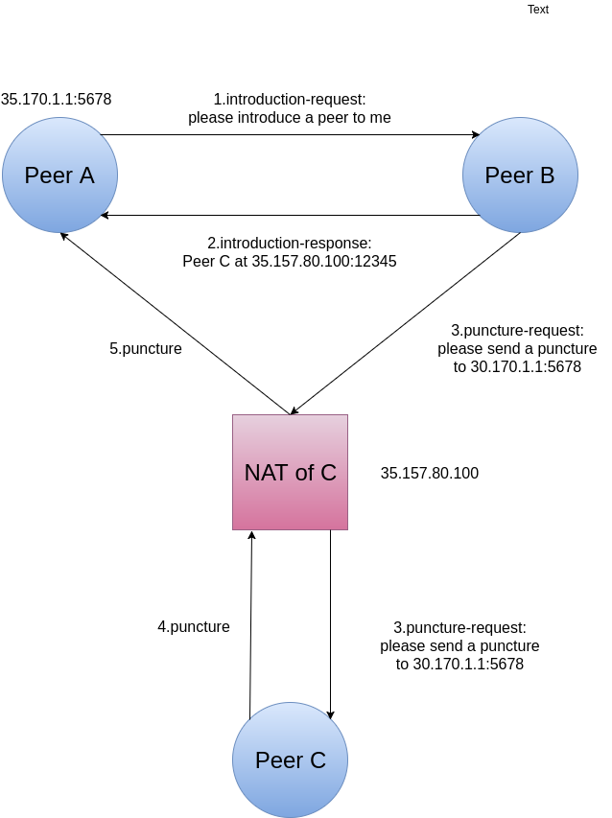
Peer Discovery in Dispersy
Notes:
We need to remember that, the hole in the NAT will last around 60 seconds, hence the lifespan of a peer is also that long. Now, we knows the introduction work flow of Dispersy Walker. There is a weakness in the protocol. Peer A asks Peer B to introduce a random Peer to it, then Peer B chooses Peer C. Notice that Peer C is chosen by Peer B, therefore, Peer B can manipulate the peer list of Peer A in some degree. The current Dispersy Walker randomly choose one peer out from its known peers to visit in next step. So, even an attacker intentionally introduce a certain peer to the Walker, the Walker might not visit it in the next step. But if the attacker has many Sybils in the network and Sybils inject sufficient number of toxic peers to the Walker, the Walker is still likely to visit a toxic peers in next steps hence being manipulate by the attacker. In other words, the Walker is still vulnerable to Misleading Attack.

Slide 17
Current Dispersy Walker
Peer Discovery Strategy = Historical records system + Trust Value Calculation Function + Walking Strategy
Has no bookkeeping system to record the historical behaviors of other peers.
Has no scoring system (reputation system) that assign trust value to other peers
Use random strategy to choose next peer to visit, not based on trust.
Notes:
As I mentioned, the thesis aim to use trust to combat Misleading Attack. The idea is calculating trust value for each peer according to its historical behaviors and determine which peer to visit in next step. But the current Dispersy Walker has no bookkeeping system to record historical behaviors, let alone the trust calculation system peer discovery strategy.

Slide 18
Trust Value and Walking Strategy
Historical behaviors record system: Trustchain [20]
Previous Work for Trust Calculation: Pim Otte’s NetFlow and PimRank.[25]
Previous Work for Walking Strategy: Pim Veldhuisen’s Focus Walking (Bias Walking).[24]
Notes:
So，we actually have three jobs: adding a historical record system to the Walker. Adding a trust value calculation system to the Walker, and add a walking strategy to the Walker. Fortunately, previous members of Tribler Team has done some research for this. The new Walker will use The Trustchain to record historical behaviors. For the trust value calculation and Walking Strategy, we can not directly apply their works to the Walker, but their works provides valuable inspirations.

Slide 19
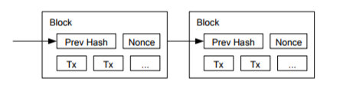
Blockchain
First introduced by Nakamoto [21]
The hash of a Block is determined by all content in this Block
Modification of anything in the Block will change the hash.
Every Block (except the first Block) contains the hash of the previous Block, the validity of a Block is based on the validity of the previous Block.
Therefore, tamper a Block will cause all following Blocks invalid.
Notes:
The Blockchain is used for such a goal: peers store the whole history of the system in a distributed fashion but still reach a global consensus on the history. The basic unit of history is called “transaction” the transaction is grouped together to from Blocks, the Blocks are chained together to form a chain, the order of Blocks reveal the orders of the history. A Block’s validity relies on the hash of previous Block, tampering the previous Block will change its hash hence invalidate all following Blocks, that prevent peers intentionally tampering or hiding Blocks.

Slide 20
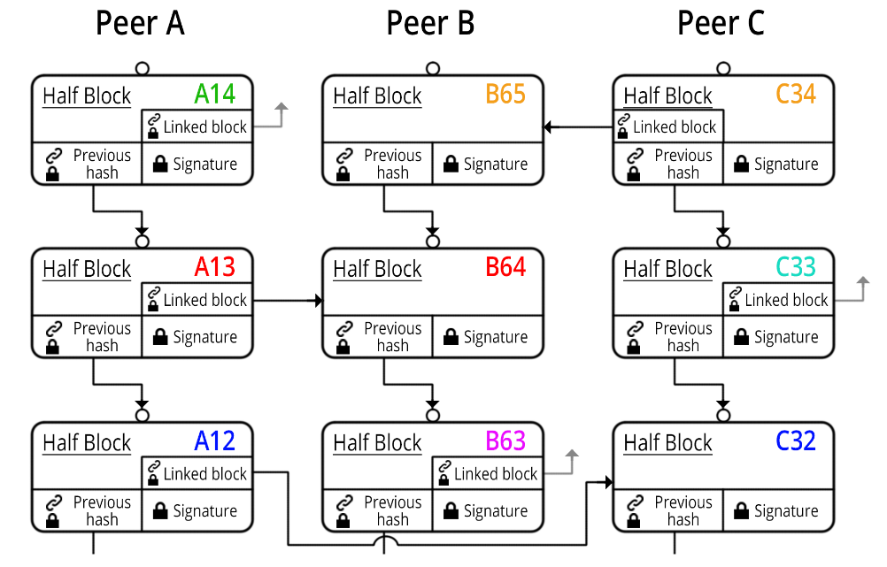
Trustchain
Notes:
Trustchain is similar to Blockchain. But unlike Blockchain, there are multiple chains in the system. Every peer has its own chain to record its own history. Peers can request the chain of other peers. Like Blockchain, Trustchain is also tamper-proof. The Trustchain system has been implemented by Tribler Team. Now, we already has a system to store the historical behaviors of other peers.

Slide 21
Trustchain
Crawl-request
Crawl-response
Notes:
Unlike Blockchain the Trustchain system doesn’t require peers to store the whole history of the network, hence it is likely that a peer has no knowledge about the historical behaviors of other peers. However, for calculating the trust value, the Walker needs the records of historical behaviors of other peers. Trustchain system allows peers to collect such records using the Crawl-request Message. When other peers receive such Messages, it will respond with a crawl-response containing one Trustchain Block, if there are multiple Blocks to return, they will reply with multiple crawl-response.

Slide 22
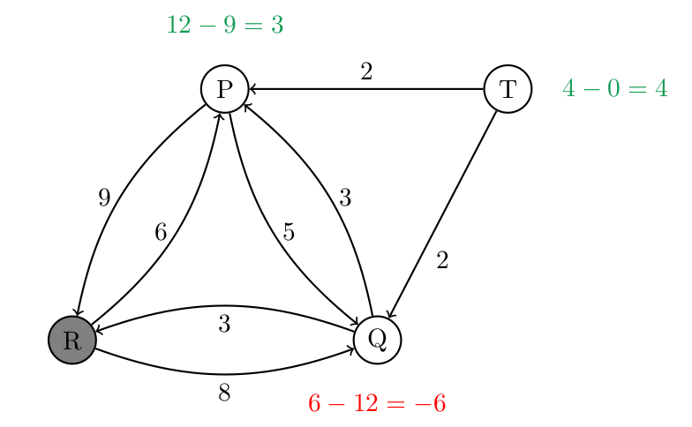
NetFlow
Notes:
The next step is to find a trust calculation system based on historical behaviors. Pim Otte proposes two algorithms for it. The first algorithm is called NetFlow, the trust value is determined by the difference among the upload from a peer to the us, and the download from the us to the peer. For example. In the graph, The upload from Peer P to R is 12 and the download from Peer R to P is 9, hence the trust value is 3.Time complexity is O(n^2m) ~ O(n^3m) where n is the number of peers and m is the number of edges.

Slide 23
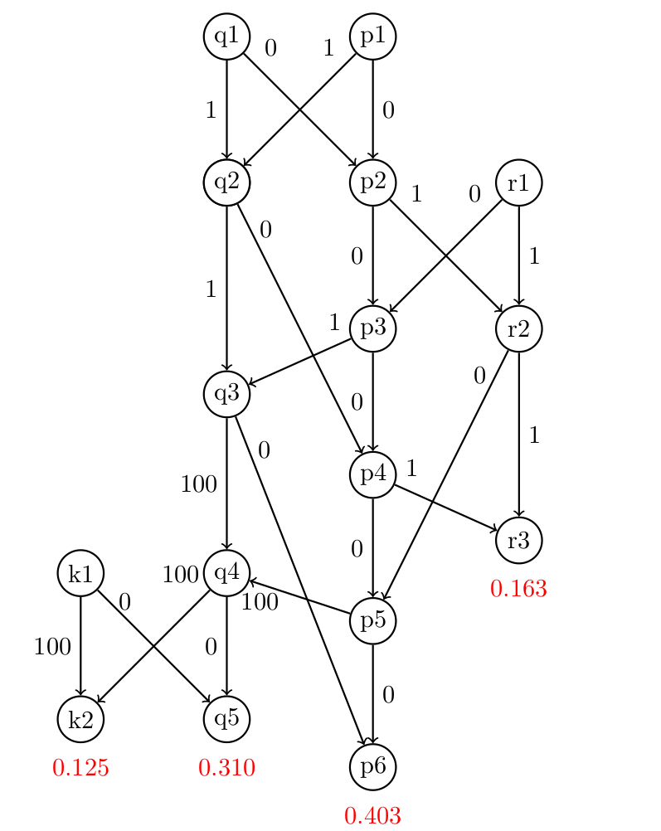
PimRank
Notes:
The second algorithm is PimRank. Pim Otte form a directed graph where nodes representing Blocks and edges representing link among peers. An “agent” start at a random node and has some probability to walker to another linked node, the probability is determined by the links. Before every step, the agent also has a probability beta to teleport a random node. With enough steps, the probability that the agent stands in every node can be calculated, hence we get a stationary probability distribution. That value is the trust value for the corresponding peers. The time complexity is O(mlog(1/sigma)) sigma is error because it is random walk. (The problem is that it is subject to the number of Blocks rather than number of peers and edges between peers. Both algorithms are too slow, according to Pim Otte, in the case that there are 20 thousand Blocks, Netflow takes 300 seconds and PimRank takes 10 seconds.

Slide 24
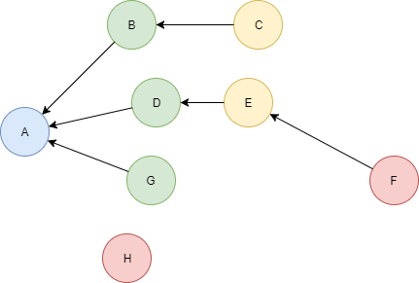
Trust Graph
Notes:
I do not have a very elegant algorithm to calculate trust, I use the concept of transitive trust. The idea is that you trust your friend and your friend’s friend but might not trust the friend’s friend’s friend. In my algorithm, the trust value is either 1 or 0, 1 is trust 0 is not. The peer trust every peer that has at least an interaction that upload some data to it. And if A trust D and D trust E and E trust F, then A trust E but not trust F. In other words, we call it 2 hops transitive trust. In fact, the Walker can specify any natural number for the k to make the Walker as a k-hop transitive trust Walker.
(It can be done by a single run of shortest path algorithm, or a broad first search with time complexity O(n^k), where n is the average number of direct trusted nodes of every peer and k is the trust path length limit.)

Slide 25
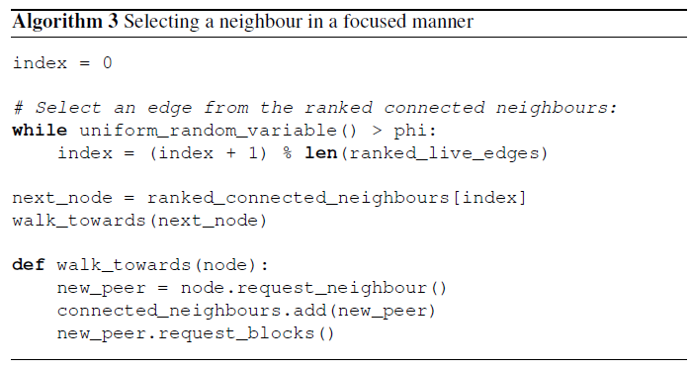
Focus Walking (Pim’s Bias Walking)
Notes:
Now we have trust calculation algorithm, we can consider about walking strategy. Pim Veldhuisen propose a walking strategy called Focus Walking in his thesis. It is actually a bias walking strategy that assign different probability to a peer according to its score. A peer with high score has greater chance to be visited in next step compared with low score peers. Pim’s bias walking strategy favors high score peers for Blocks collecting consideration. However, for combating Misleading Attack, we should also favor high scores peers, more specifically, favors high trust value peers. For the reason that high trust peers benefits you a lot in the past hence is not likely to suddenly obtain some motivations to do harm to you. In addition, a Sybil is less likely to obtain high trust value compared with a normal peer. But the Pim’s bias walking strategy encounter load balance issues, we will talk about it later.

Slide 26
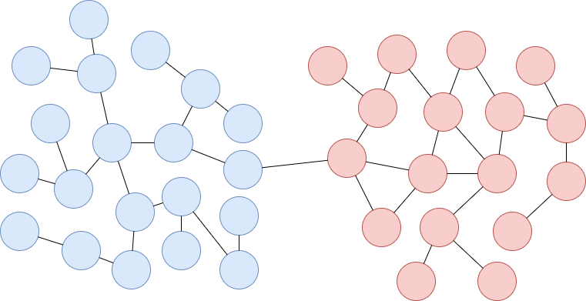
Inspiration from SybilGuard
Notes:
SybilGuard is a defense mechanism designed to applied in social networks. It cannot be directly applied to Dispersy. However, a model it assumes can be applied to Dispersy Network. The model is that the network can be divided into two regions -- the honest region and the Sybil Region. The edges connected the two regions are called attack edges. The attack edges should be few in number. This model also holds in Dispersy context. So, in the Sybil prevention experiment, we will also use a setting like this.（if have time, also say the following:）Remember that edges represent the uploading interactions between peers. Hence creating attack edges is much harder than creating Sybils, hence the attack edges are few in number compared with the number of sybils. With this model, we actually obtain the idea to combat Misleading Attack. The essence of Misleading Attack is that the attacker injects toxic address (for example, the address of a sybil) to the honest region via the attack edges. Every time it successfully inject a sybil address, it actually establishes an attack edges. Injecting more toxic address result in more attack edges hence further increase the injection speed. Remember that peers have finite lifespan, hence all attack edges will finally timeout. we actually have another loop: decrease the probability to visit Sybils will decrease the speed in establishing attack edges. As time goes by, the old attack edges will finally time out hence the number of attack edges decrease, further decrease the injection speed. And we believe the key to reduce the probability to visit Sybils is favoring trusted peers more than random peers.

Slide 27
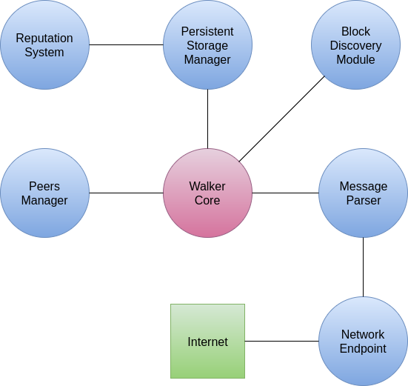
Walker Architecture
Notes:
The architecture of the Walker is here. The Network Endpoint listening on a certain port, hand in the relevant packets to Message Parser, Message Parser then parse the packets to Dispersy Messages. Walker Core will take different actions according to pre defined protocol and the Message type. It may use Peer Manager to retrieve, store address of peers. It may use Block Discovery Module to discovery Trustchain Blocks from other peers. It may also use persistent storage Manager to store Blocks or calcualting the reputation of other peers, the reputation is the trust value.

Slide 28
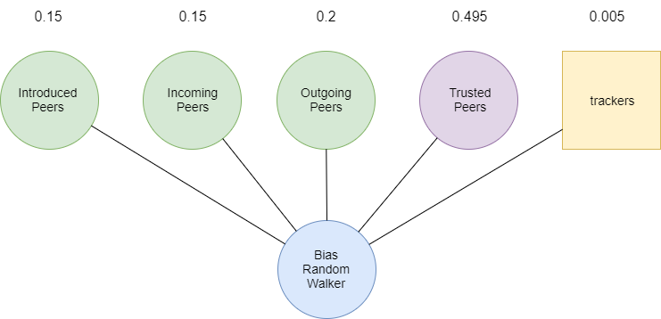
Bias Random Walker
Notes:
We actually create two kinds Walkers with trust-based peer discovery strategy. They use the same trust calculation algorithm and different walking strategy. The first one is a Bias Random Walker, like the bias walker of Pim, it assigns different probability to different type of peers. Notice that the outgoing peers, incoming peers and introduced peers are all untrusted peers.

Slide 29
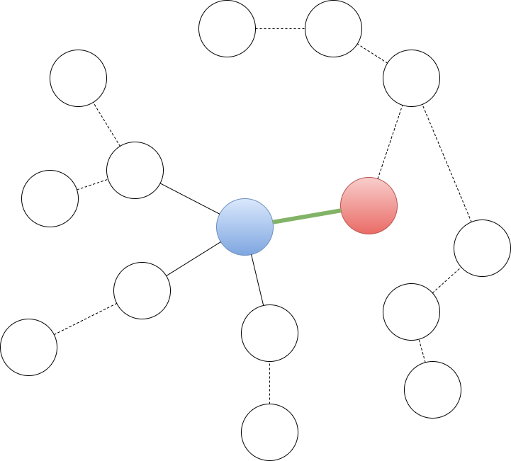
Teleport Walker
Notes:
The second Walker is teleport Walker. The Walker will always visit the latest introduced peer and visit peers along a random path. But it will has a certain chance beta to teleport to the starting point and take another peer to start a new random path.

Slide 30
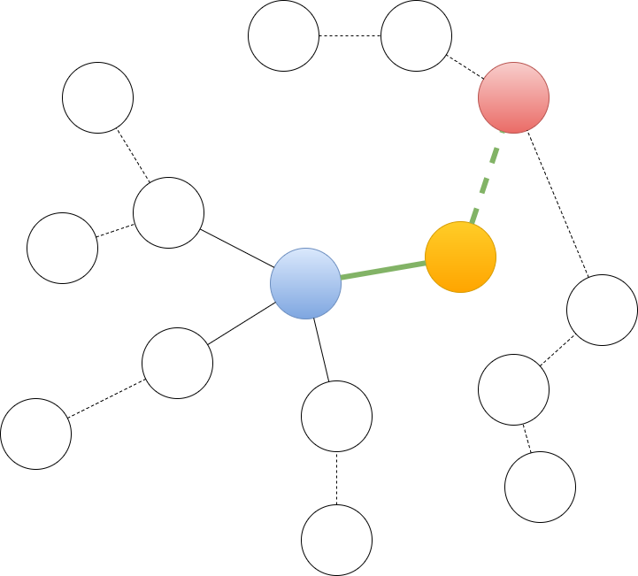
Teleport Walker

Slide 31
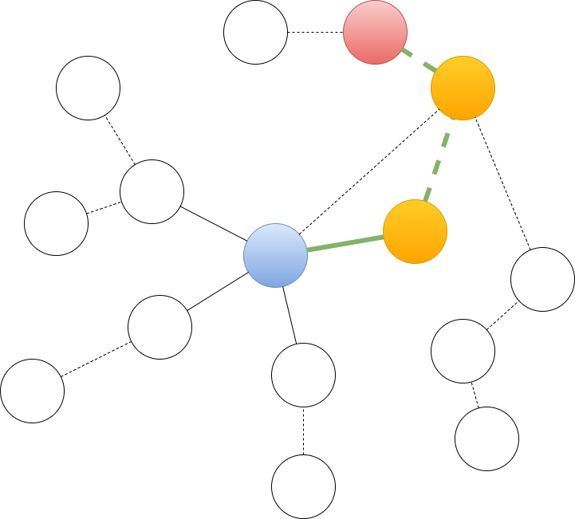
Teleport Walker

Slide 32
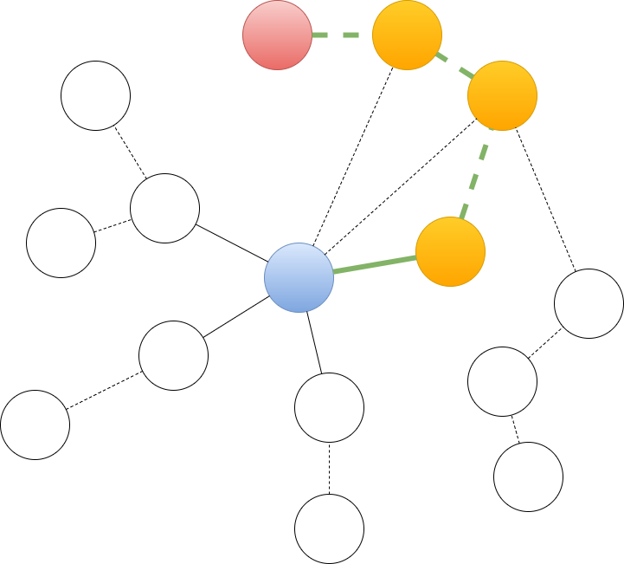
Teleport Walker

Slide 33
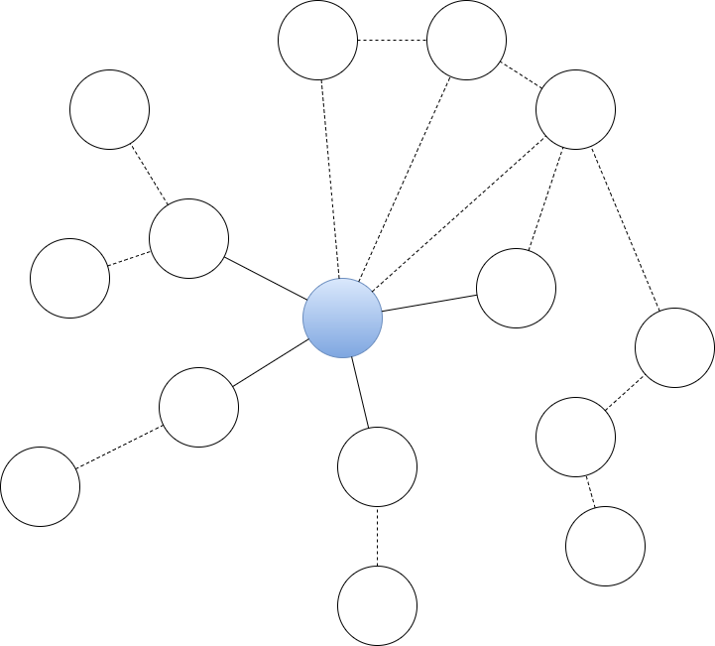
Teleport Walker

Slide 34
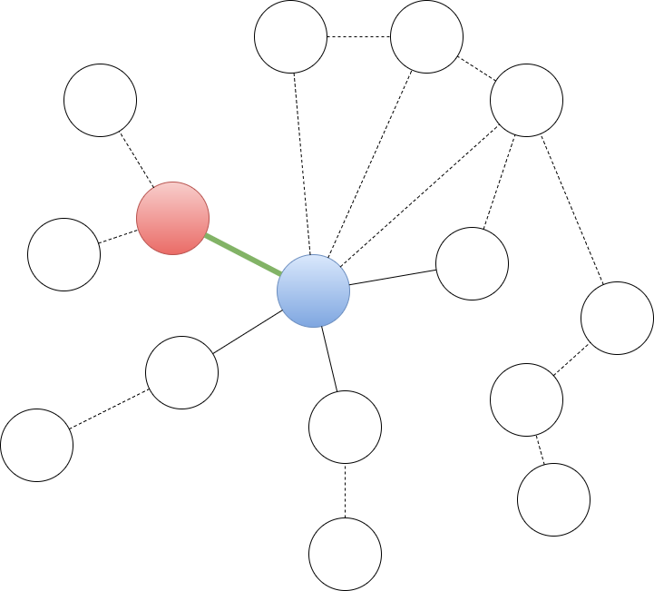
Teleport Walker

Slide 35
Validation
Coverage Validation
Load Balance Validation
Sybil Prevention Validation
Notes:
We now get the Walker with trust based peer discovery strategy, we need to validate their performance. There are three validations need to be done. The first is Coverage Validation. As a Walker, our new Walker should be able to explore the whole network with sufficient steps rather than only discover a small subset of peers. Second validation is to ensure that the new Walkers will not cause serious load balance problem. The third validate is to test the ability to counter Sybil Attack, or more specifically, Misleading Attack.

Slide 36
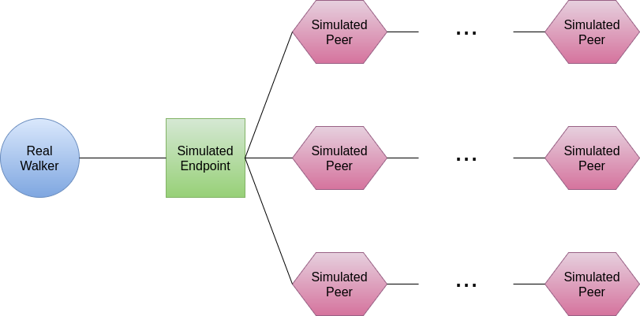
Simulated Network
Notes:
The validations will be conducted in simulated network. There are multiple simulated peers in the network, such peers will not actively send any Messages but will respond to incoming messages like real Walker. The simulated peers communicate with each other with their own language rather than Dispersy Messages, so, to communicate with real Walker, they need a Simulated Endpoint for translation. There is only one Real Walker in the network. The network will conduct peer discovery in the simulated network, we will record the data for validation.

Slide 37
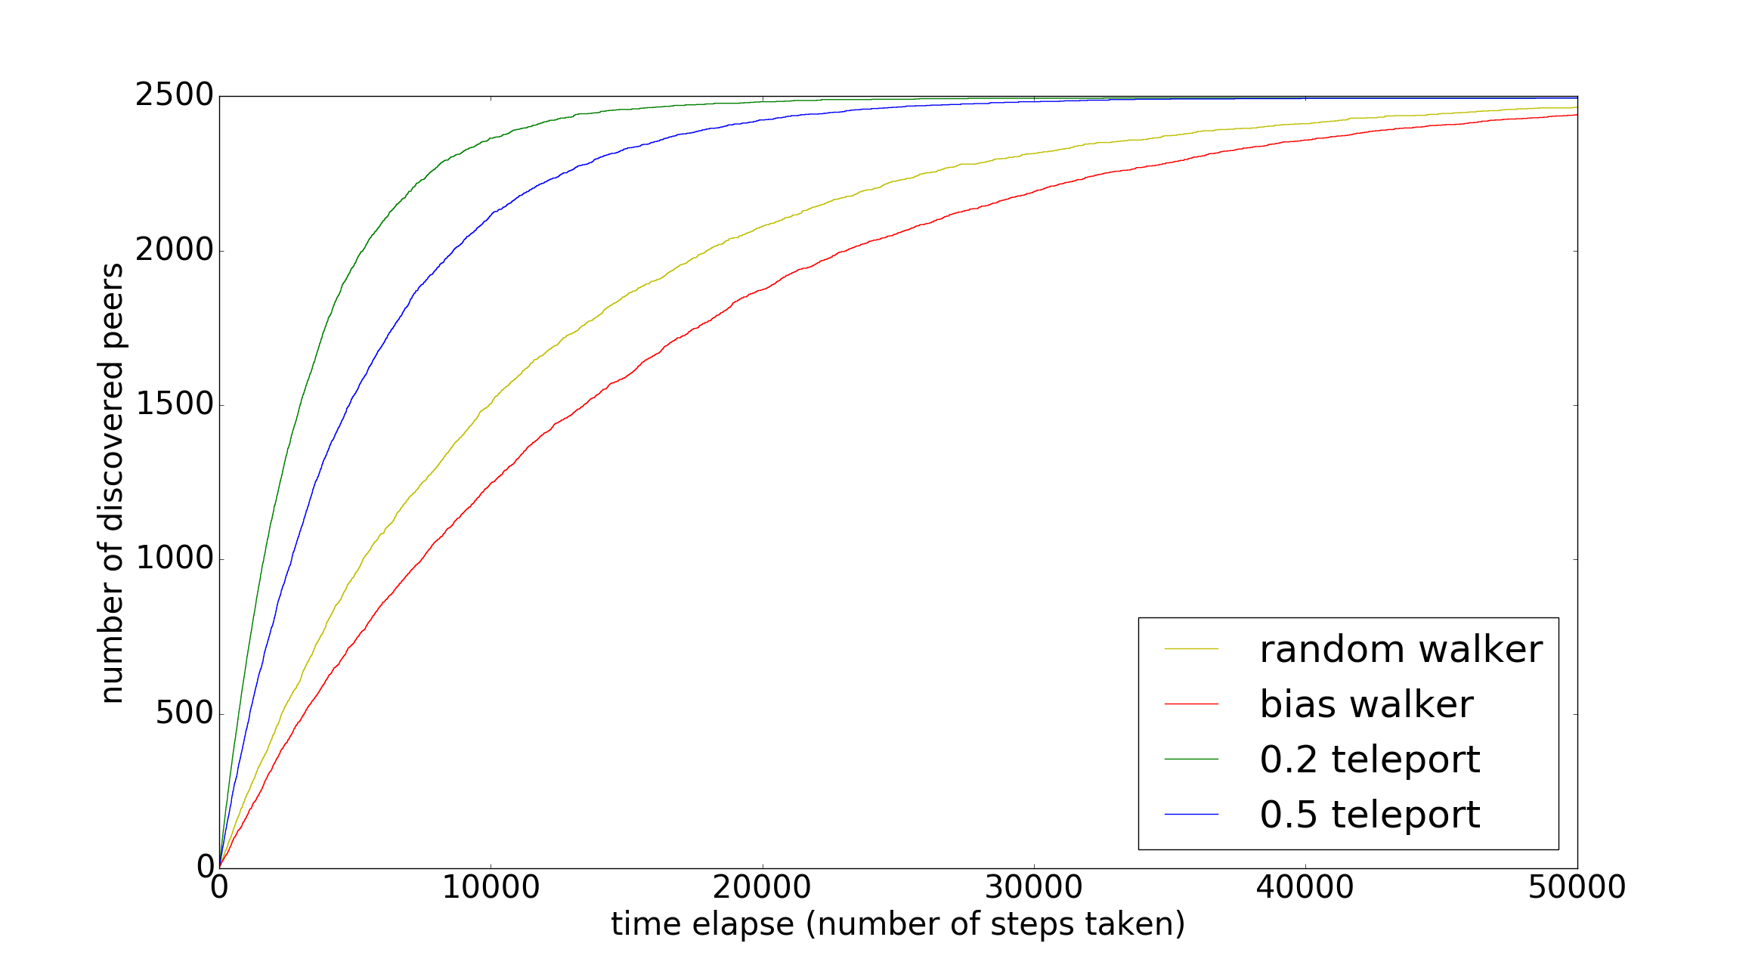
Coverage Validation
Notes:
For the Coverage Validation, the real Walker conduct peer discovery in a simulated network with 2500 simulated peers, the real Walkers take 50 thousand steps in the network, the number of discovered peers overtime is recored, the result for the 4 types of Walkers are shown above. According to the result, the 4 Walkers vary in peer discovery speed but all fulfill the requirement that it should be able to well explore the network with sufficient steps.

Slide 38
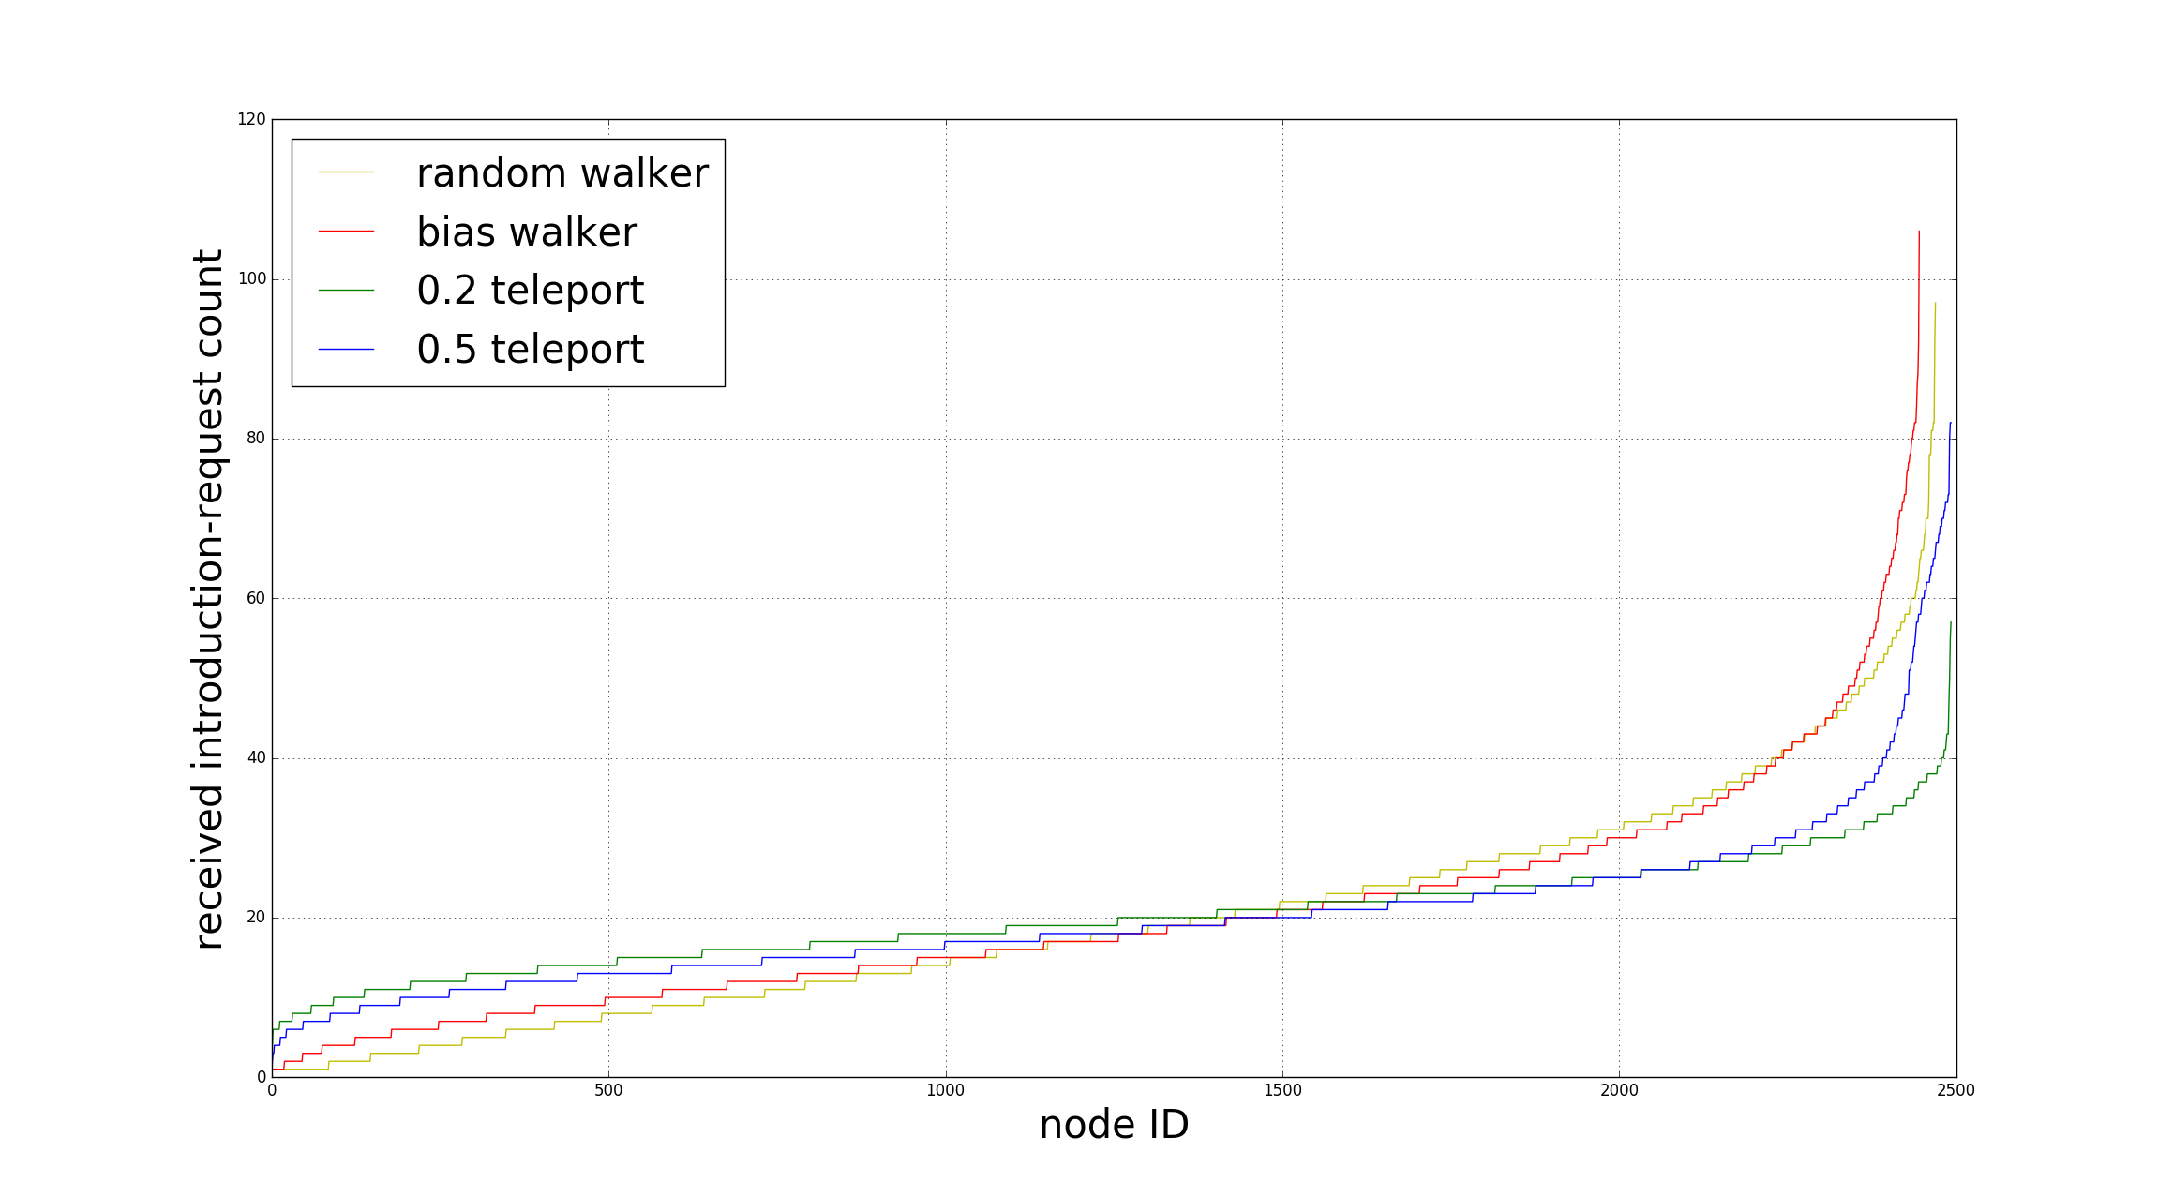
Load Balance Validation
Notes:
The Load Balance Validation use a completely network settings with Coverage Validation. The result is shown on the screen, the x-axis is the node ID rank by the number of introduction-request received, for example, the peer with Node ID 0 receive the least introduction request, the greater the Node ID, the more introduction request it receives. The performance of Bias Random walker is close to random Walker, which is the current Dispersy Walker, serves as our base line. The Teleport Walkers perform better than Random walker.

Slide 39
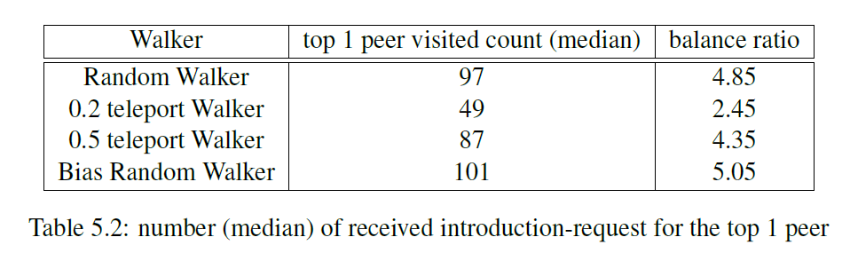
Load Balance Validation

Slide 40
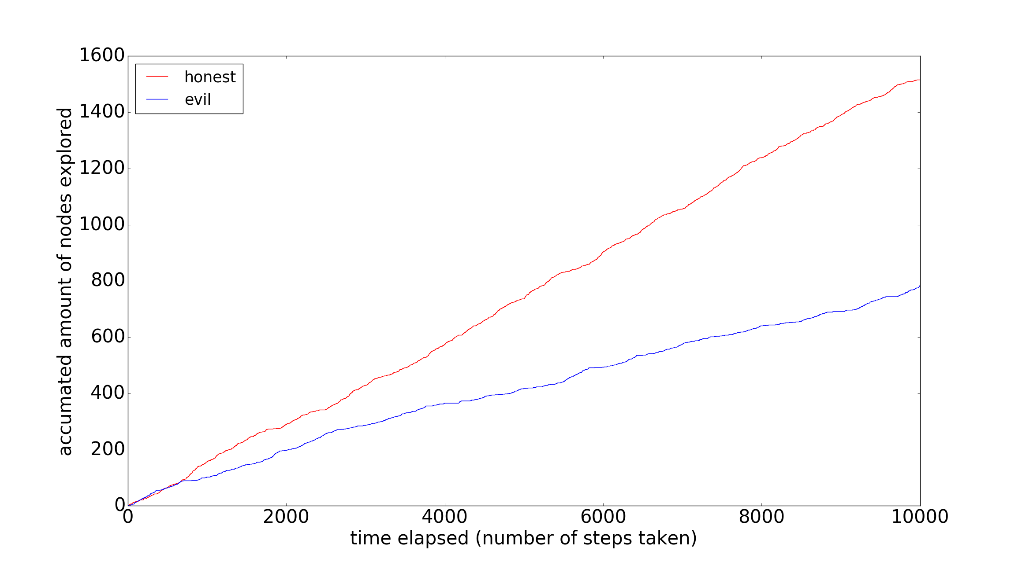
Sybil Prevention Validation
Notes:
The third validation is a little more complex. The Walkers take 10 thousand steps in the simulated network with 1 million peers. 300 thousand of them are honest peers and 700 thousand of them are evil peers. In the case there are 200 thousand attack edges, we record the number of honest and evil peers discovered overtime, the data is shown on the screen. For a certain timestamp, we can always calculate the ratio that the number of discovered evil peers divided by the number of honest peers.

Slide 41
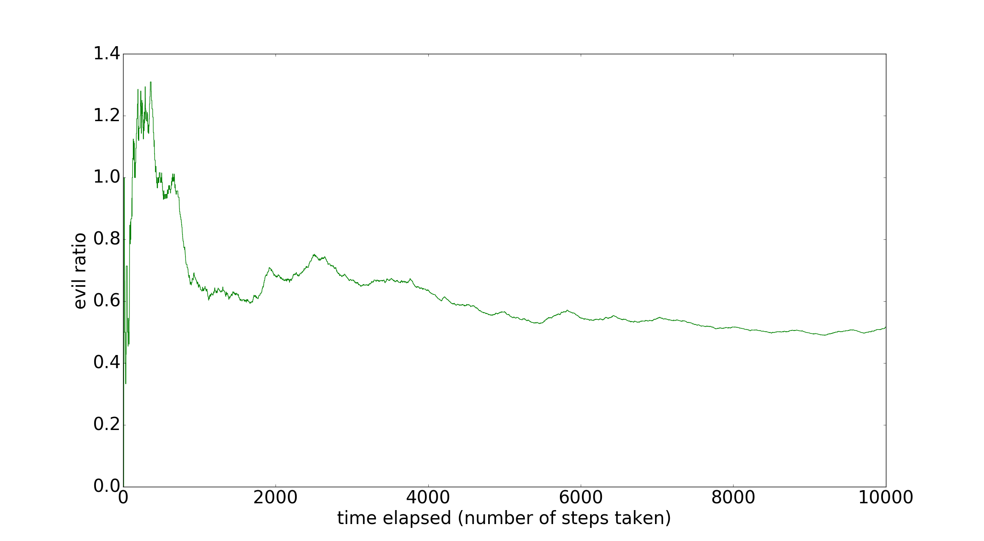
Sybil Prevention Validation
Notes:
The result is on the screen. As we can see, with sufficient time, the ratio will be stable at the level around 0.6. Notice that it is the result when there are 200 thousand attack edges. Our intuition tells us when there are more attack edges, the attack strength will be greater, as well as the evil ratio.

Slide 42
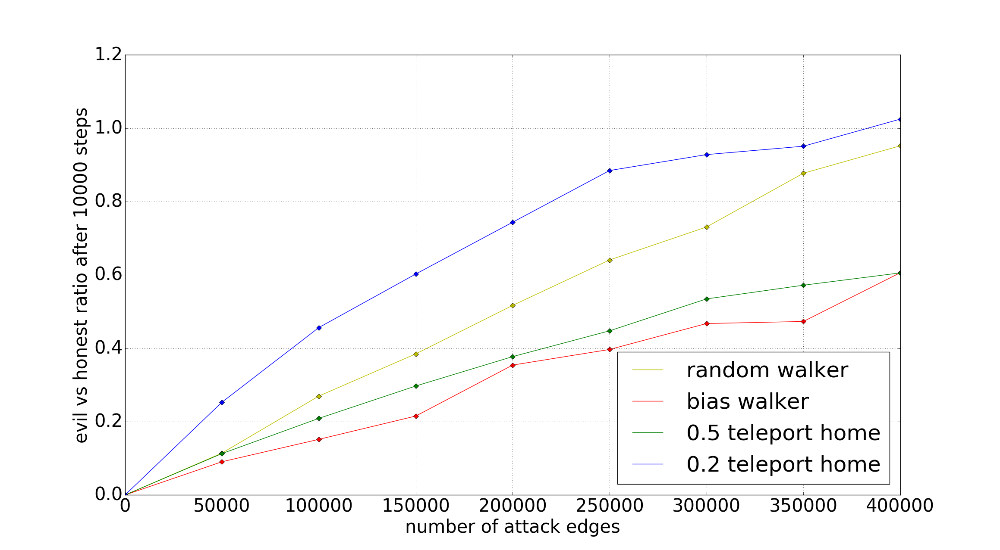
Sybil Prevention Validation
Notes:
The result of evil ratio in the situations with different attack edges are shown on the screen. There are 4 curves representing four Walkers. Basically, the lower the curve, the better the performance. According to it, the Bias Random Walker perform best and the Teleport Walker with 0.5 teleport home probability is the second, they are both better than the random walker, the baseline.

Slide 43
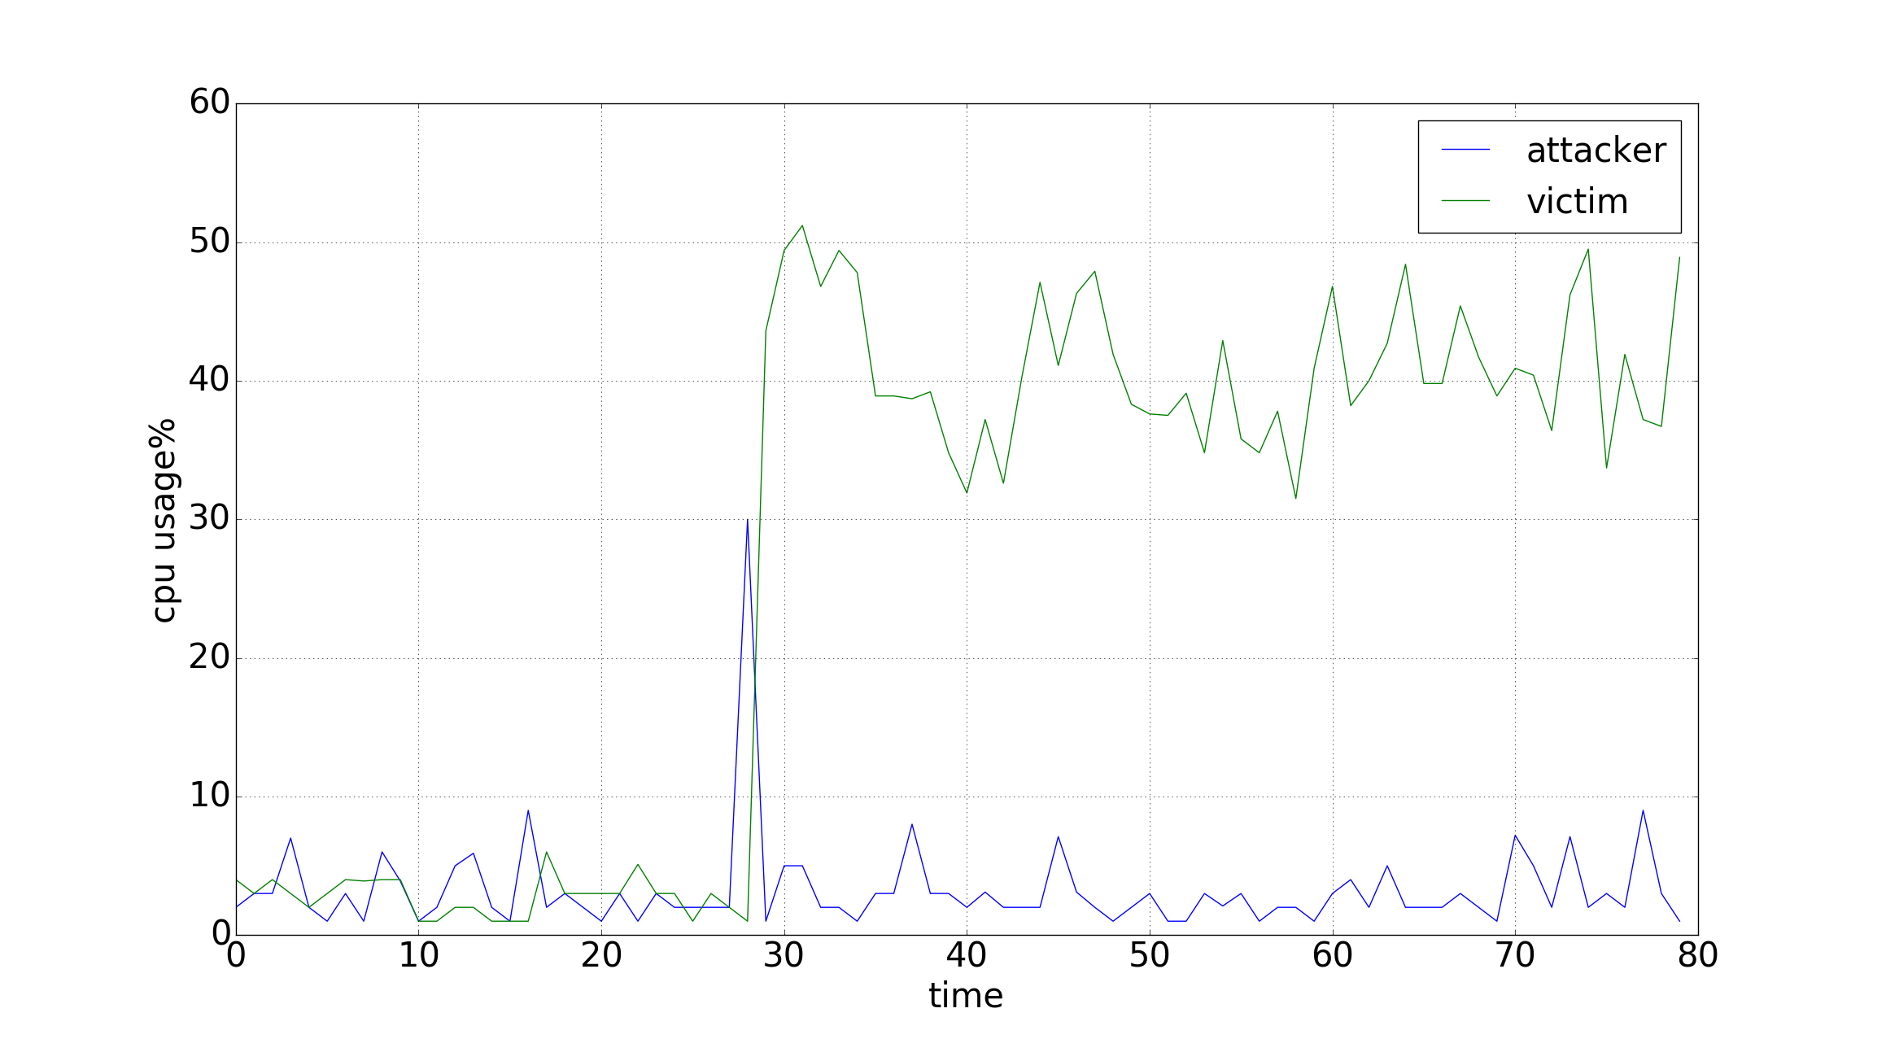
Unsolved Problem
Notes:
By now, our research goal is actually achieved. We have implemented the Walkers with trust based peer discovery strategy. They pass all validations hence meet all requirements. However, by using the Trustchain system, we actually introduce a new problem. By default setting, when receive a crawl-request, a peer can return up to 100 crawl-response Messages, that enforce heavier burden on the crawl-responder than the crawl-requester. But even we reduce the number from 100 to 1, the burden for the responder is still greater than that of requester. The problem roots in the fact that requester can store the binary string of crawl-request hence can reuse it easily while the responder has to create new crawl-response message every time.

Slide 44
Conclusion
Research goal is achieved
Bias Random Walker and Teleport Walker both meet coverage requirement
They both meet load balance requirement
They both meet Sybil prevention requirement
Research Goals achieved
But by using Trustchain, we introduce the crawl-request flooding problem.
Notes:
Our new Walkers pass all validation. Now we can draw the conclusion that we achieve all the research goals.

Slide 45
Limitaion
Simulated Network cannot 100% emulate the real network.
Cannot analytically determine the optimal k for the k-hop transitive trust.

Slide 47

Questions

Slide 48

Insert a picture

Slide 49
Bibliography
[1] A. S. Tanenbaum and M. Van Steen, Distributed systems: Principles and paradigms. Prentice-Hall, 2007.
[2] R. Schollmeier, ‘A definition of peer-to-peer networking for the classification of peer-to-peer architectures and applications’,in Peer-to-Peer Computing, 2001. Proceedings. First International Conference on, IEEE, 2001, pp. 101–102.
[3] ERNESTO. (2015). Bittorrent still dominates internet upstream traffic, [Online].Available: https://torrentfreak.com/bittorrent-still-dominates-internets-upstream-traffic151208/.
[4] B. Cohen. (2017). Bitorrent protocol specification, [Online]. Available: http://www.bittorrent.org/beps/bep_0003.html.
[5] D. Evans, ‘The internet of things: How the next evolution of the internet is changing everything’, CISCO white paper, vol. 1, no. 2011, pp. 1–11, 2011.

Slide 50
Bibliography
[6] Wikipedia. (2017). List of network protocols (osi model) — wikipedia, the free encyclopedia. [Online; accessed 24-September-2017 ], [Online]. Available: https://en.wikipedia.org/w/index.php?title=List_of_network_protocols_(OSI_model)&oldid=794023617.
[7] P. Maymounkov and D. Mazieres, ‘Kademlia: A peer-to-peer information system based on the xor metric’, in International Workshop on Peer-to-Peer Systems, Springer, 2002, pp. 53–65.
[8] D. Clip, Gnutella protocol specification v0. 4, 2007.
[9] M. Ripeanu, ‘Peer-to-peer architecture case study: Gnutella network’, in Peer-to-Peer Computing, 2001. Proceedings. First International Conference on, IEEE, 2001, pp. 99–100.

Slide 51
Bibliography
[10] G. Fodor, E. Dahlman, G. Mildh, S. Parkvall, N. Reider, G. Mikl´os and Z. Tur´anyi, ‘Design aspects of network assisted device-to-device communications’, IEEE Communications Magazine, vol. 50, no. 3, 2012.
[11] S. Helal, N. Desai, V. Verma and C. Lee, ‘Konark-a service discovery and delivery protocol for ad-hoc networks’, in Wireless Communications and Networking, 2003. WCNC 2003. 2003 IEEE, IEEE, vol. 3, 2003, pp. 2107–2113.
[12] L.Wang and J. Kangasharju, ‘Real-world sybil attacks in bittorrent mainline dht’, in Global Communications Conference (GLOBECOM), 2012 IEEE, IEEE, 2012, pp. 826–832.
[13] Wikipedia. (Sep. 2017). Denial of service attack, [Online]. Available: https: //en.wikipedia.org/wiki/Denial-of-service_attack.
[14] J. Mirkovic and P. Reiher, ‘A taxonomy of ddos attack and ddos defense mechanisms’, ACM SIGCOMM Computer Communication Review, vol. 34,no. 2, pp. 39–53, 2004.

Slide 52
Bibliography
[15] D. Senie and P. Ferguson, ‘Network ingress filtering: Defeating denial of service attacks which employ ip source address spoofing’, Network, 1998.
[16] J. R. Douceur, ‘The sybil attack’, in International Workshop on Peer-to-Peer Systems, Springer, 2002, pp. 251–260.
[17] Wikipedia. (Aug. 2017). Donald trump twitter following might include more than 4 million bots, [Online]. Available: https://en.wikipedia. org/wiki/SYN_flood.
[18] L. Lamport, ‘Time, clocks, and the ordering of events in a distributed system’, Communications of the ACM, vol. 21, no. 7, pp. 558–565, 1978.
[19] M. Meulpolder, J. A. Pouwelse, D. H. Epema and H. J. Sips, ‘Bartercast: A practical approach to prevent lazy freeriding in p2p networks’, in Parallel & Distributed Processing, 2009. IPDPS 2009. IEEE International Symposium on, IEEE, 2009, pp. 1–8.

Slide 53
Bibliography
[20] D. N. Steffan, ‘Multichain: A cybercurrency for cooperation’, 2015.
[21] S. Nakamoto, ‘Bitcoin: A peer-to-peer electronic cash system’, 2008.
[22] wikipedia. (2015). Scalability-bitcoin, [Online]. Available: https://en.
bitcoin.it/wiki/Scalability.
[23] V. inc. (2014). Visa inc. at a glance, [Online]. Available: https://usa.visa.com/dam/VCOM/download/corporate/media/visafact-sheet-Jun2015.pdf.
[24] P. Veldhuisen, ‘Leveraging blockchains to establish cooperation’, MSc thesis, Delft University of Technology, May 2017.
[25] P. Otte, ‘Sybil-resistant trust mechanisms in distributed systems’, MSc thesis,Delft University of Technology, Dec. 2016.

Slide 54
Bibliography
[26] H. Yu, M. Kaminsky, P. B. Gibbons and A. Flaxman, ‘Sybilguard: Defending against sybil attacks via social networks’, in ACM SIGCOMM Computer Communication Review, ACM, vol. 36, 2006, pp. 267–278.
[27] Amazon. (Sep. 2017). Amazon ec2 instance types, [Online]. Available: https://aws.amazon.com/ec2/instance-types/.
[28] Wikipedia. (2017). Syn flood, [Online]. Available: https://en.wikipedia.org/wiki/SYN_flood.
[29] S. Milgram, ‘The small-world problem’, Psychology Today, vol. 1, no. 1,1967.61

Slide 55
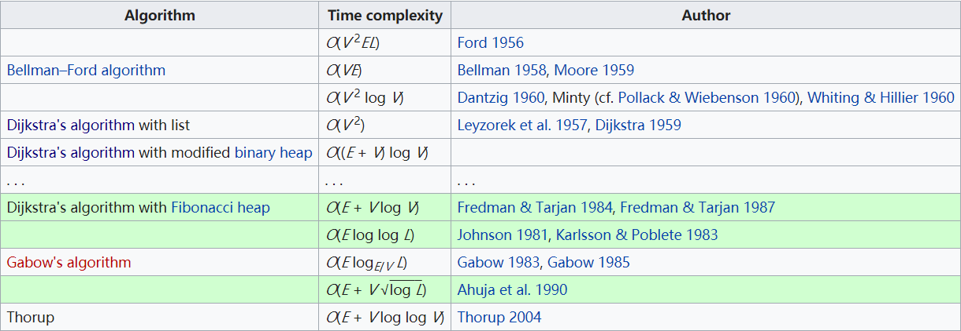
Appendix 1 – shortest path time complexity

